Slide 1
Football League Scores
Mohammed Alghazi X18208495
Andrew Kelly X18212158
David Sloan X19120192

Slide 2

Agenda
Brief description
How the project works
Conclusion

Slide 3
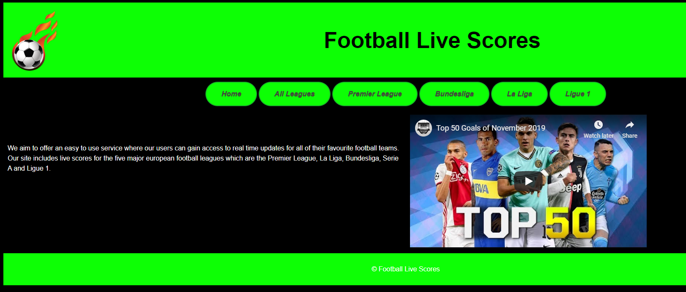
Website home page
The above image is displaying the home page for our website

Slide 4
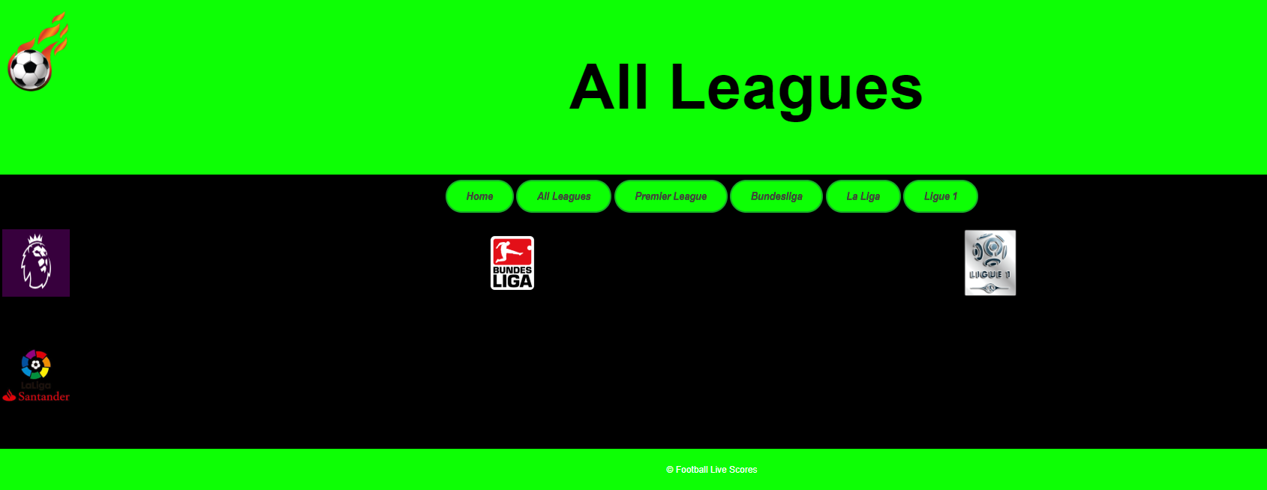
The image above shows that when the user clicks on all leagues, they are then given an option on which league would they like to see from the 2018/2019 season

Slide 5
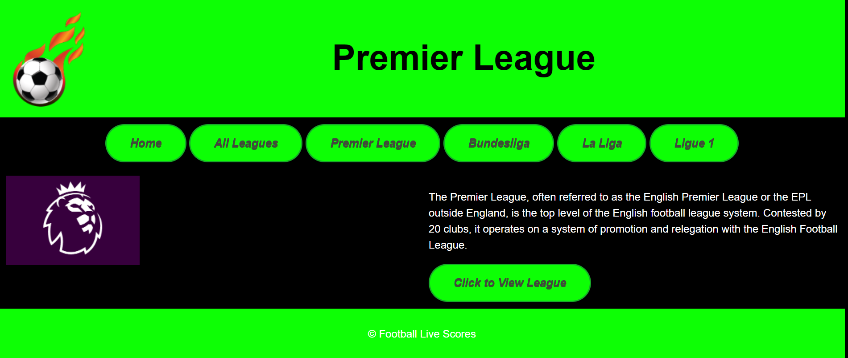
The above images show the user can click on any of the displayed leagues in the main menu, for this example we have chosen the English Premier League.

Slide 6
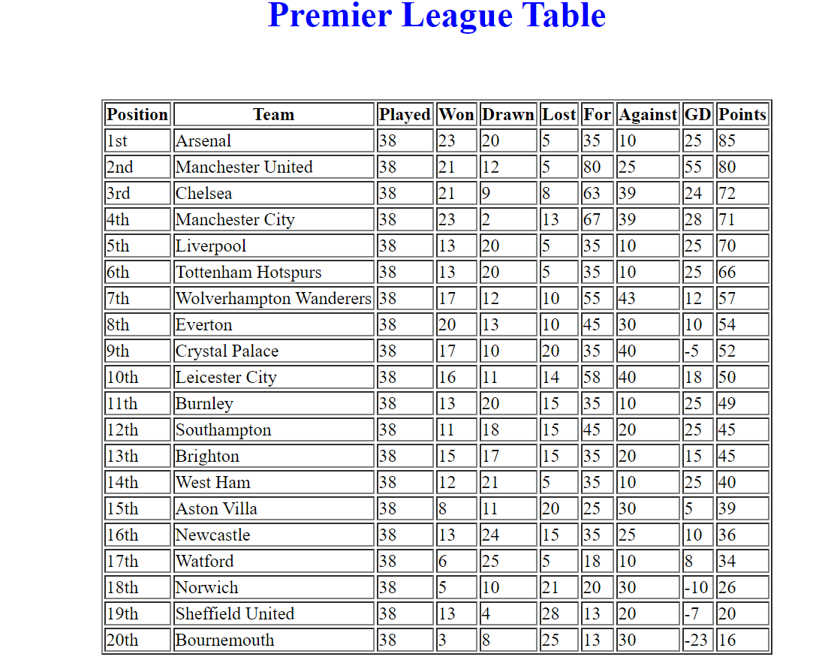
When the user clicks on the button “View League Table” he is then directed to the table

Slide 7
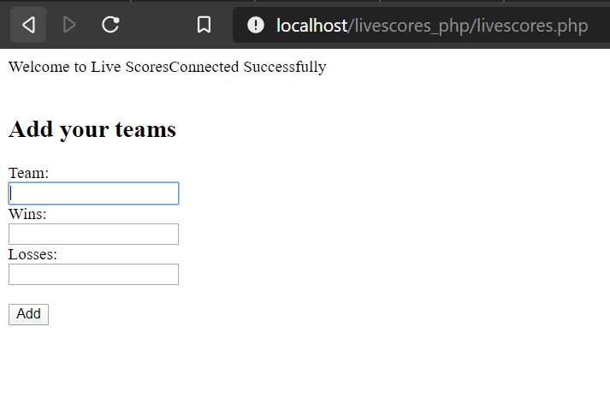
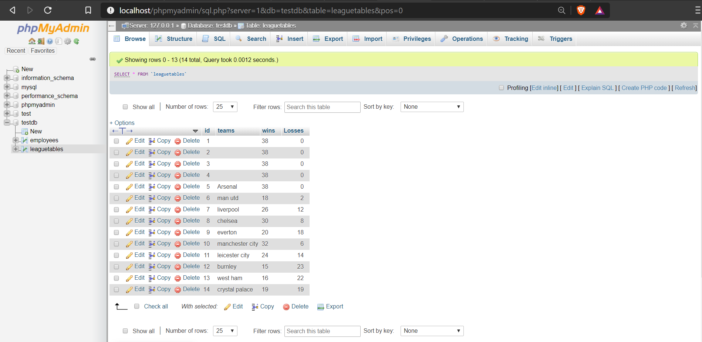
The website is connected to MySQL

Slide 8
Live link to the website
leagueScores.epizy.com
we hosted our project on Infinity Free, which is a free hosting website for educational purpose.

Slide 9

Conclusion
We came across a lot of challenges and worked very hard to overcome them.
We are very happy with the end result of our project and believe we built a good site that hits the requirements set out in the project brief

Slide 10

Thank You for listening, Any Questions?

